Slide 1

Data Engineer Test
By Muhammad Rizky Halawi

Slide 2
Content
01
Preparation
02
Process The Question
03
Problem while do This Project

Slide 3
Preparation of This Project
The Data:
Master Data_Data Engineer
Scan Record Data
Important things:
Waybill No.: Unique ID
Origin Branch: Origins Area Packet
POD Branch : Destinations Area
Destination: Destination of district
Record Time: Time of Packet get pickup
POD Time: Time of Packet already Delivered
Arrival Scan: Time of Packet Arrive at Branch
Delivery Scan: Time of Packet Start to deliver at Destination

Slide 4



Tools
Pyton: for Analyze Data
Jupyter Notebook: Make a Script
Tableau : for Data Vizualization
4

Slide 5
Question
01
03
Data Cleansing
02
Make a New Data
Measure Time Interval
04
Measure mean of Interval time
For Each Branch
05
Data Visualization

Slide 6
Processing

Slide 7
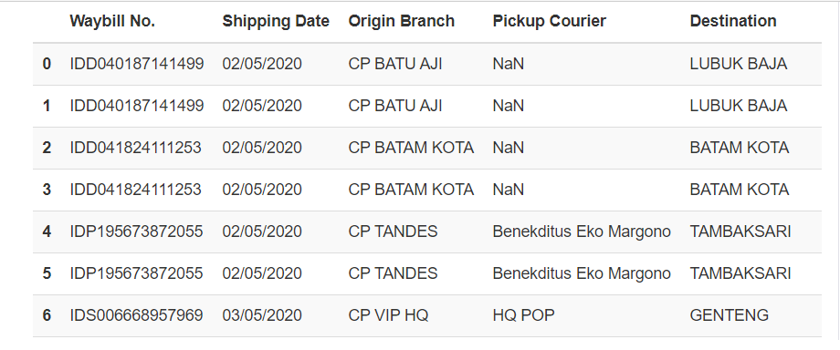
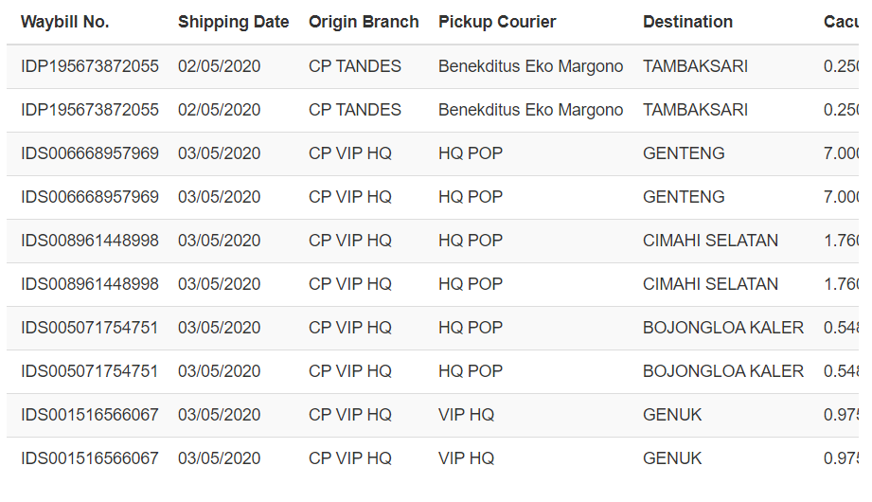
Data Cleansing
Import data and read data
Before
Merge data and profilling
Check missing data and delete
Check Duplicates
After
Delete missing and duplicate
Last Data Profiling

Slide 8
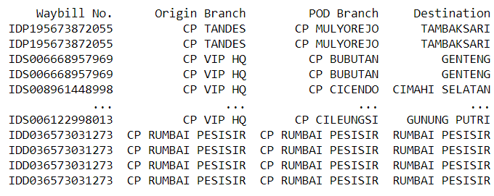
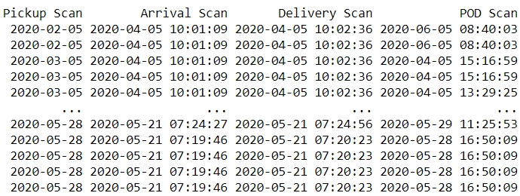
New Data
Result:
Data Checking
Make new Columns Depend on Request (Arrival and Delivery Scan)
Change from Object to Datetime Data
Make New Data Frame Depend on Request

Slide 9
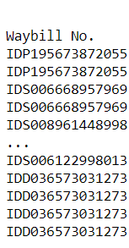
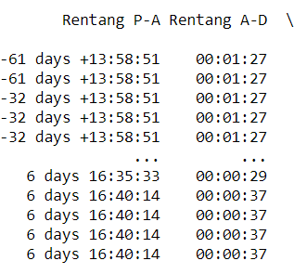
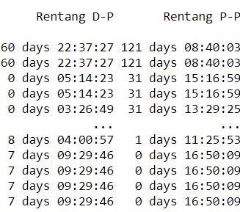
Measure Time Interval
Data Checking
Result:
Make new Columns
Make the Operation Depend on request
Check the Result
Request Notes:
Must measure between:
Pickup Scan – Arrival Scan
Arrival Scan – Delivery Scan
Delivery Scan – POD Time
Pickup Scan – POD Time

Slide 10
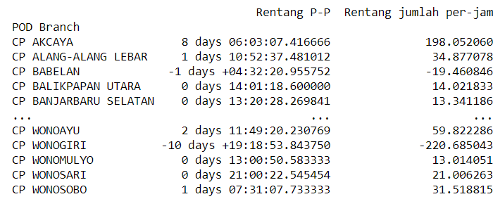
Mean interval time of each Branch
Data Checking
Result:
Import datetime
Measure Mean of Each Branch
Make to Data Frame
Code to Measure mean for each Branch:
data_CP= master_data.groupby('POD Branch')['Rentang P-P'].mean(numeric_only=False)
df = pd.DataFrame(data_CP)
print(df)

Slide 11
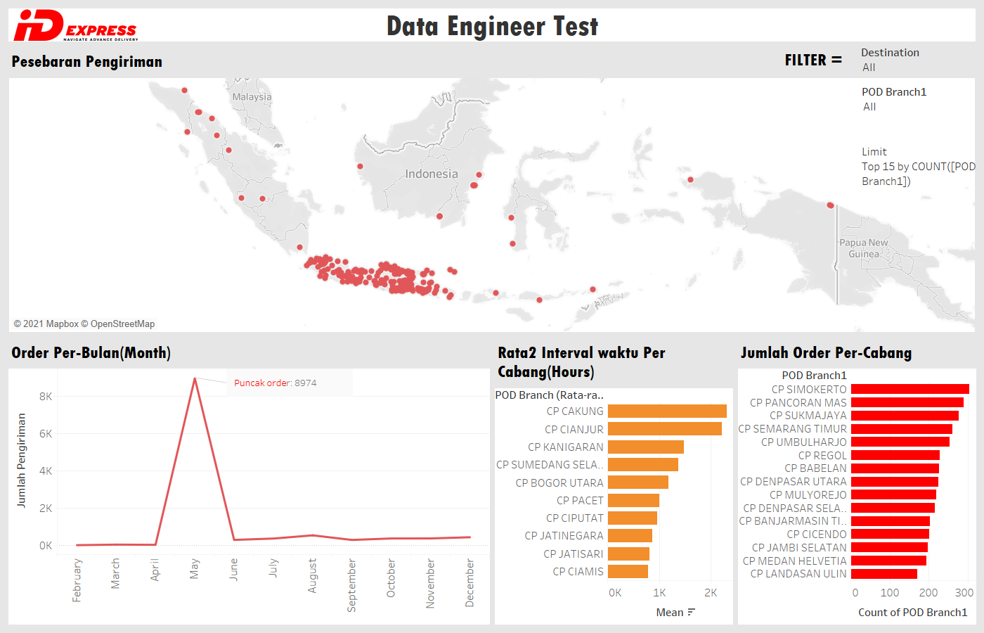
Data Visualization

Slide 12
Problem While do this Project
Problem make and Analyze the data:
Problem make a Visualization Data:
Confuse to merge and choose the data. (what a columns must I used)
have Problem in Indentify the data
sometimes need thinking more than twice for make simply data to next analyze
have problem to operation with different data types
Have bad internet
need to much time to decides what code I used.
need more time to decides what visualization I used
Have problem to connect more than one data
to much data can’t read by the maps Graphic (Longitude, Latitude)

Slide 13
THANK YOU
13

Slide 14

Contact Me
https://github.com/MRHalawi12
rizkyhalawi@gmail.com
DRAMAGA, BOGOR, INDONESIA
14

